Slide 1
Managing Office 365 without the admin center

Slide 3
Who this talk is for…
You already know some PowerShell
You know your way around the Office 365 admin center
You’re not your company’s automation wizard or devops guru

Slide 4
Agenda
Using PowerShell
PowerShell and Office 365
Get Involved!
Alternative to PowerShell

Slide 5

Using PowerShell

Slide 6
PowerShell you say?
Some tasks are only available in PowerShell
Anything you need to do more than once
Automating tasks should be one of your life goals

Slide 7
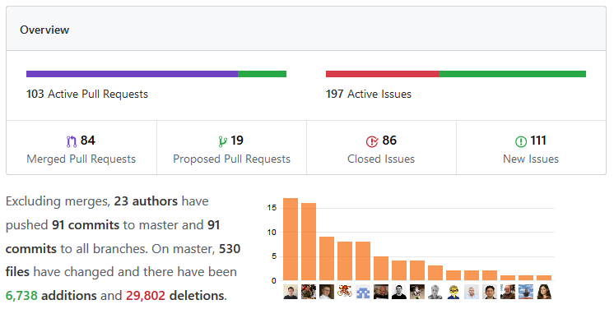
Sharing is Caring
PowerShell is open source now
https://github.com/PowerShell
May 2018 - June 2018

Slide 8
There’s two versions of PowerShell
PowerShell
PowerShell Core
The old and trusted
.NET Framework
Windows only
powershell.exe
versions 1.0 > 5.1
continues to be supported
The new kid on the block
.NET Core
Cross platform
pwsh.exe
version 6 and beyond
the way forward
Both versions can be used side-by-side on the same system

Slide 9

PowerShell Core is upon us!
PowerShell Core 6.0 was released in January of 2018
Currently at version 6.1.0
Cross-platform: Windows, macOS and Linux
sudo apt-get install powershell

Slide 10
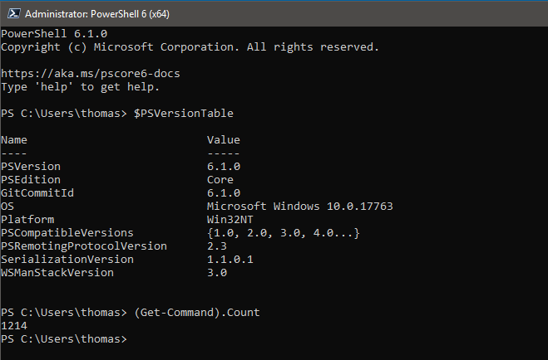
PowerShell Core

Slide 11
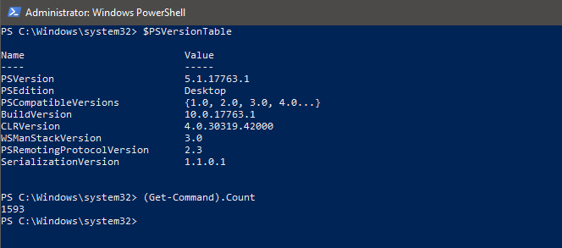
Windows PowerShell

Slide 12
PowerShell hosts & editors
PowerShell console
PowerShell ISE - Deprecated
Visual Studio Code

Slide 13
Visual Studio Code for authoring & debugging
Don’t worry - you don’t have to be a developer
VSCode is extensible & customizable
Great for authoring
Takes some getting used to for debugging
You need the PowerShell extension!

Slide 14
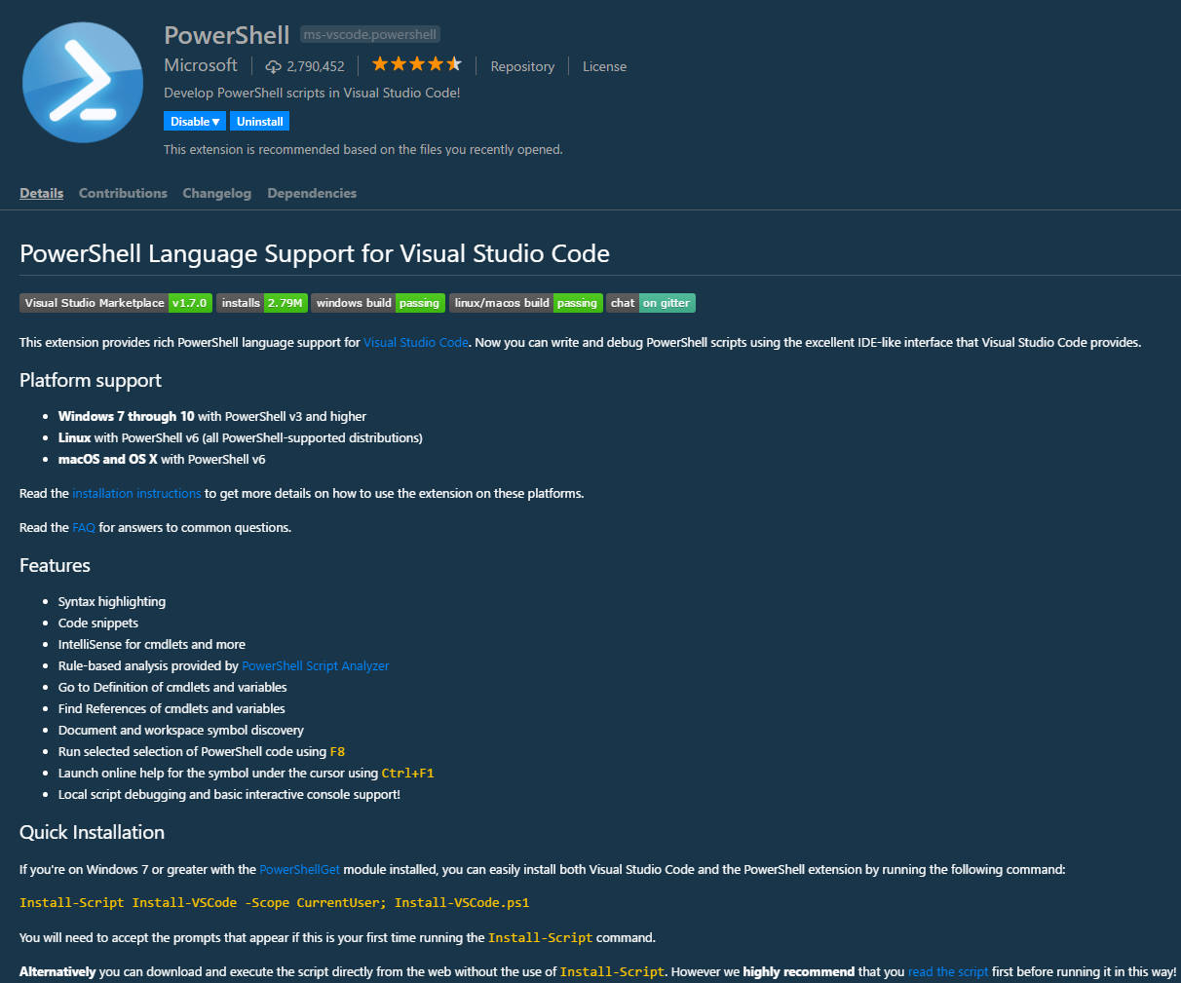

Slide 15
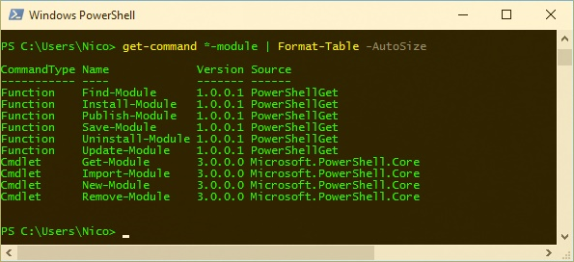
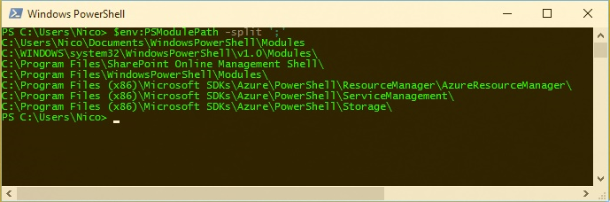
Working with Modules 101
Functionality is delivered through modules
Download manually or use the PowerShell Gallery https://www.powershellgallery.com/
[verb]-Module
How to know where to find them?
How to know which ones you have installed?

Slide 16
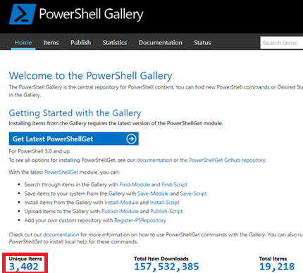
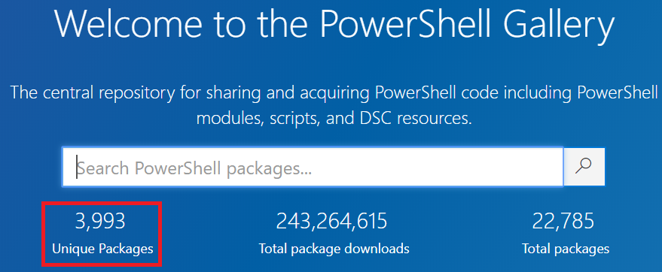
Working with Modules 101 - Community
Github
"Cloud for code"
Private / public repositories
PowerShell Gallery
One stop shop for all published PowerShell content Juni 2018

Slide 17

PowerShell and Office 365

Slide 18
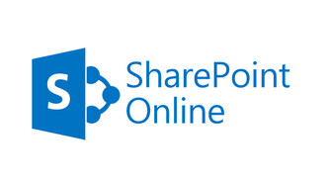





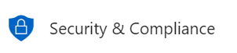
Office 365 PowerShell Overview
Notes:
AzureAD: Connect-AzureAD -Credential
Microsoft Teams: Connect-MicrosoftTeams -Credential
SharePoint Online: Connect-SPOService -Credential
PNP: Connect-PNPOnline -Credentials
Exchange: $Session = New-PSSession -ConfigurationName Microsoft.Exchange -ConnectionUri https://outlook.office365.com/powershell-liveid/ -Credential $UserCredential -Authentication Basic -AllowRedirection
Security & Compliance: $Session = New-PSSession -ConfigurationName Microsoft.Exchange -ConnectionUri https://ps.compliance.protection.outlook.com/powershell-liveid/ -Credential $UserCredential -Authentication Basic -AllowRedirection Skype for Business Online: New-CSOnlineSession -Credential
Overview of modules: https://docs.microsoft.com/en-us/office365/enterprise/powershell/manage-office-365-with-office-365-powershell

Slide 19
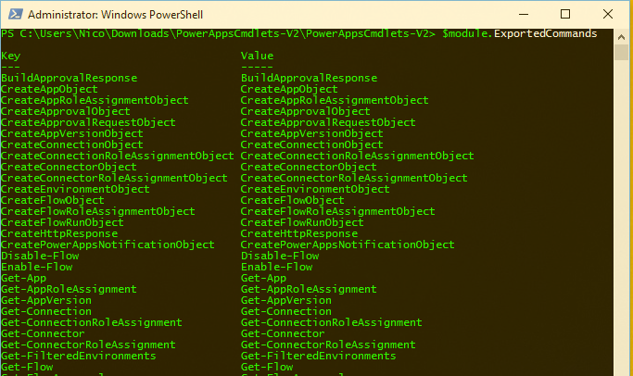
Flow & PowerApps (preview)

Slide 20
Prerequisites
Office 365 Admin Role (Global or service admin, depending on which service you want to use)
Windows 7 SP1 or higher
The necessary modules: https://docs.microsoft.com/en-us/office365/enterprise/powershell/manage-office-365-with-office-365-powershell

Slide 21
Installing remaining modules
Install-Module AzureAD
Install-Module MSOnline
Install-Module MicrosoftTeams
Install-Module Microsoft.Online.SharePoint.PowerShell
Install-Module SharePointPnPPowerShellOnline
https://github.com/SharePoint/PnP-PowerShell

Slide 22

Are you confused yet?

Slide 23
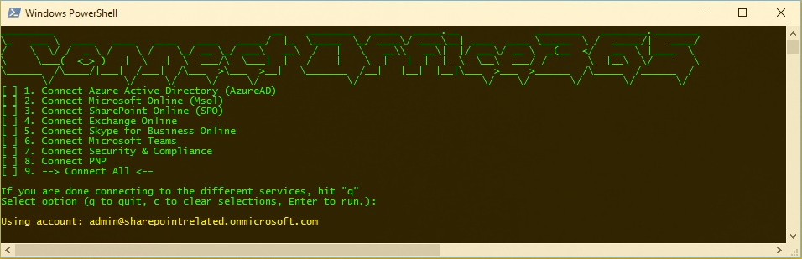
…or use the power of community!
https://www.powershellgallery.com/packages/Office365.Connect/
Connect-Office365 -Tenant "sharepointrelated"

Slide 24
When to use which module?
Cmdlet contains | Module
*-Msol* | MSOnline
*-AzureAD* | AzureAD
*-SPO* | Microsoft.Online.SharePoint.PowerShell
*-CS* | SkypeOnlineConnector
*-Team* | MicrosoftTeams
*-CC* | SecurityCompliance
*-PnP* | SharePointPnPPowerShellOnline

Slide 25
What about SharePoint?
Admin tasks Content
Anything that would
require CSOM PowerShell
VS
Install-Module –Name SharePointPnPPowerShellOnline

Slide 26
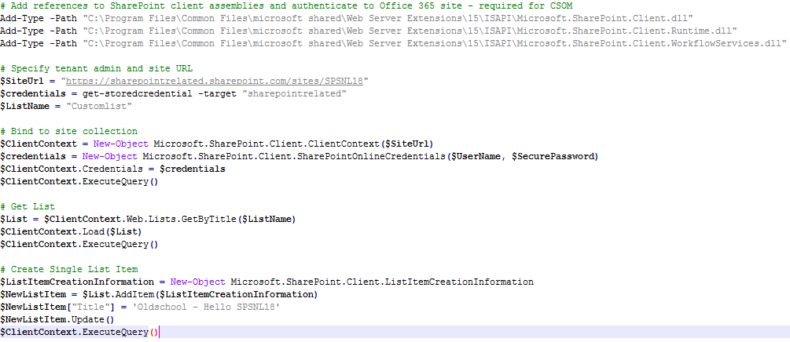
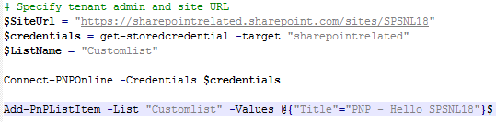
SharePoint Online PowerShell vs PNP
Add a list item - SharePoint Online PowerShell
Add a list item - PNP PowerShell
Notes:
https://gist.github.com/azam-a/eba51bfbf922d34e8c87

Slide 27
300+ Commandlets
Add-PnPContentType
Add-PnPContentTypeToDocumentSet
Add-PnPContentTypeToList
Add-PnPCustomAction
Add-PnPDataRowsToProvisioningTemplate
Add-PnPDocumentSet
Add-PnPEventReceiver
Add-PnPField
Add-PnPFieldFromXml
Add-PnPFieldToContentType
Add-PnPFile
Add-PnPFileToProvisioningTemplate
Add-PnPFolder
Add-PnPHtmlPublishingPageLayout
Add-PnPIndexedProperty
Add-PnPJavaScriptBlock
Add-PnPJavaScriptLink
Add-PnPListFoldersToProvisioningTemplate
Add-PnPListItem
Add-PnPMasterPage
Add-PnPNavigationNode
Add-PnPPublishingImageRendition
Add-PnPPublishingPage
Add-PnPPublishingPageLayout
Add-PnPTaxonomyField
Add-PnPUserToGroup
Add-PnPView
Add-PnPWebPartToWebPartPage
Add-PnPWebPartToWikiPage
Add-PnPWikiPage
Add-PnPWorkflowDefinition
Add-PnPWorkflowSubscription
Apply-PnPProvisioningTemplate
Clear-PnpRecycleBinItem
Clear-PnPTenantRecycleBinItem
Connect-PnPMicrosoftGraph
Connect-PnPOnline
Convert-PnPFolderToProvisioningTemplate
Convert-PnPProvisioningTemplate
Copy-PnPFile
Disable-PnPFeature
Disable-PnPResponsiveUI
Disconnect-PnPOnline
Enable-PnPFeature
Enable-PnPResponsiveUI
Ensure-PnPFolder
Execute-PnPQuery
Export-PnPTaxonomy
Export-PnPTermGroupToXml
Find-PnPFile
Get-PnPAccessToken
Get-PnPAppInstance
Get-PnPAuditing
Get-PnPAuthenticationRealm
Get-PnPAzureADManifestKeyCredentials
Get-PnPContentType
Get-PnPContentTypePublishingHubUrl
Get-PnPContext
Get-PnPCustomAction
Get-PnPDocumentSetTemplate
Get-PnPEventReceiver
Get-PnPFeature
Get-PnPField
Get-PnPFile
Get-PnPFolder
Get-PnPFolderItem
Get-PnPGroup
Get-PnPGroupPermissions
Get-PnPHealthScore
Get-PnPHomePage
Get-PnPIndexedPropertyKeys
Get-PnPJavaScriptLink
Get-PnPList
Get-PnPListItem
Get-PnPMasterPage
Get-PnPProperty
Get-PnPPropertyBag
Get-PnPProvisioningTemplate
Get-PnPProvisioningTemplateFromGallery
Get-PnPPublishingImageRendition
Get-PnPRecycleBinItem
Get-PnPRequestAccessEmails
Get-PnPSearchConfiguration
Get-PnPSite
Get-PnPSiteClosure
Get-PnPSiteCollectionTermStore
Get-PnPSitePolicy
Get-PnPSiteSearchQueryResults
Get-PnPStoredCredential
Get-PnPSubWebs
Get-PnPTaxonomyItem
Get-PnPTaxonomySession
Get-PnPTenantRecycleBinItem
Get-PnPTenantSite
Get-PnPTerm
Get-PnPTermGroup
Get-PnPTermSet
Get-PnPTheme
Get-PnPTimeZoneId
Get-PnPUnifiedGroup
Get-PnPUserProfileProperty
Get-PnPView
Get-PnPWeb
Get-PnPWebPart
Get-PnPWebPartProperty
Get-PnPWebPartXml
Get-PnPWebTemplates
Get-PnPWikiPageContent
Get-PnPWorkflowDefinition
Get-PnPWorkflowSubscription
Import-PnPAppPackage
Import-PnPTaxonomy
Import-PnPTermGroupFromXml
Import-PnPTermSet
Install-PnPSolution
Invoke-PnPWebAction
Load-PnPProvisioningTemplate
Move-PnPFile
Move-PnPFolder
Move-PnpRecycleBinItem
New-PnPExtensbilityHandlerObject
New-PnPGroup
New-PnPList
New-PnPPersonalSite
New-PnPProvisioningTemplate
New-PnPProvisioningTemplateFromFolder
New-PnPTenantSite
New-PnPTerm
New-PnPTermGroup
New-PnPTermSet
New-PnPUnifiedGroup
New-PnPUser
New-PnPWeb
Remove-PnPContentType
Remove-PnPContentTypeFromDocumentSet
Remove-PnPContentTypeFromList
Remove-PnPCustomAction
Remove-PnPEventReceiver
Remove-PnPField
Remove-PnPFieldFromContentType
Remove-PnPFile
Remove-PnPFileFromProvisioningTemplate
Remove-PnPFolder
Remove-PnPGroup
Remove-PnPIndexedProperty
Remove-PnPJavaScriptLink
Remove-PnPList
Remove-PnPListItem
Remove-PnPNavigationNode
Remove-PnPPropertyBagValue
Remove-PnPPublishingImageRendition
Remove-PnPTaxonomyItem
Remove-PnPTenantSite
Remove-PnPTermGroup
Remove-PnPUnifiedGroup
Remove-PnPUserFromGroup
Remove-PnPView
Remove-PnPWeb
Remove-PnPWebPart
Remove-PnPWikiPage
Remove-PnPWorkflowDefinition
Remove-PnPWorkflowSubscription
Rename-PnPFile
Rename-PnPFolder
Request-PnPReIndexList
Request-PnPReIndexWeb
Restore-PnpRecycleBinItem
Restore-PnPTenantRecycleBinItem
Resume-PnPWorkflowInstance
Save-PnPProvisioningTemplate
Send-PnPMail
Set-PnPAppSideLoading
Set-PnPAuditing
Set-PnPAvailablePageLayouts
Set-PnPContext
Set-PnPDefaultColumnValues
Set-PnPDefaultContentTypeToList
Set-PnPDefaultPageLayout
Set-PnPDocumentSetField
Set-PnPFileCheckedIn
Set-PnPFileCheckedOut
Set-PnPGroup
Set-PnPGroupPermissions
Set-PnPHomePage
Set-PnPIndexedProperties
Set-PnPList
Set-PnPListItem
Set-PnPListPermission
Set-PnPMasterPage
Set-PnPMinimalDownloadStrategy
Set-PnPPropertyBagValue
Set-PnPProvisioningTemplateMetadata
Set-PnPRequestAccessEmails
Set-PnPSearchConfiguration
Set-PnPSiteClosure
Set-PnPSitePolicy
Set-PnPTaxonomyFieldValue
Set-PnPTenantSite
Set-PnPTheme
Set-PnPTraceLog
Set-PnPUnifiedGroup
Set-PnPUserProfileProperty
Set-PnPWeb
Set-PnPWebPartProperty
Set-PnPWikiPageContent
Stop-PnPWorkflowInstance
Submit-PnPSearchQuery
Uninstall-PnPAppInstance
Uninstall-PnPSolution

Slide 28
Commandlet categories
Administration
Add-ins
Branding
Content Types
Document Sets
Event Receivers
Features
Fields
Files
Information Managements
Lists
Principals (users / groups)
Provisioning
Publishing
Recycle bin
Search
Taxonomy
User Profiles
Web Parts
Workflows

Slide 29
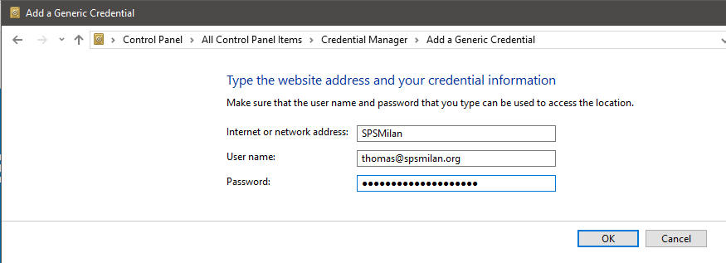
Don’t store passwords in your scripts!
Prompt for credentials, or better:
Use the CredentialManager module Install-Module CredentialManager
$credential = Get-StoredCredential SPSMilan

Slide 30
Write your own!
Contribute to open source
Learn how to write & document modules
Plaster
Pester
PlatyPS
PSScriptAnalyzer
Learn Git & Github
Learn to use Visual Studio Code
Notes:
Contribute to docs.Microsoft.com

Slide 31
Alternative to PowerShell

Slide 32
What, no PowerShell?
Introducing the Office 365 CLI
https://github.com/pnp/office365-cli

Slide 33
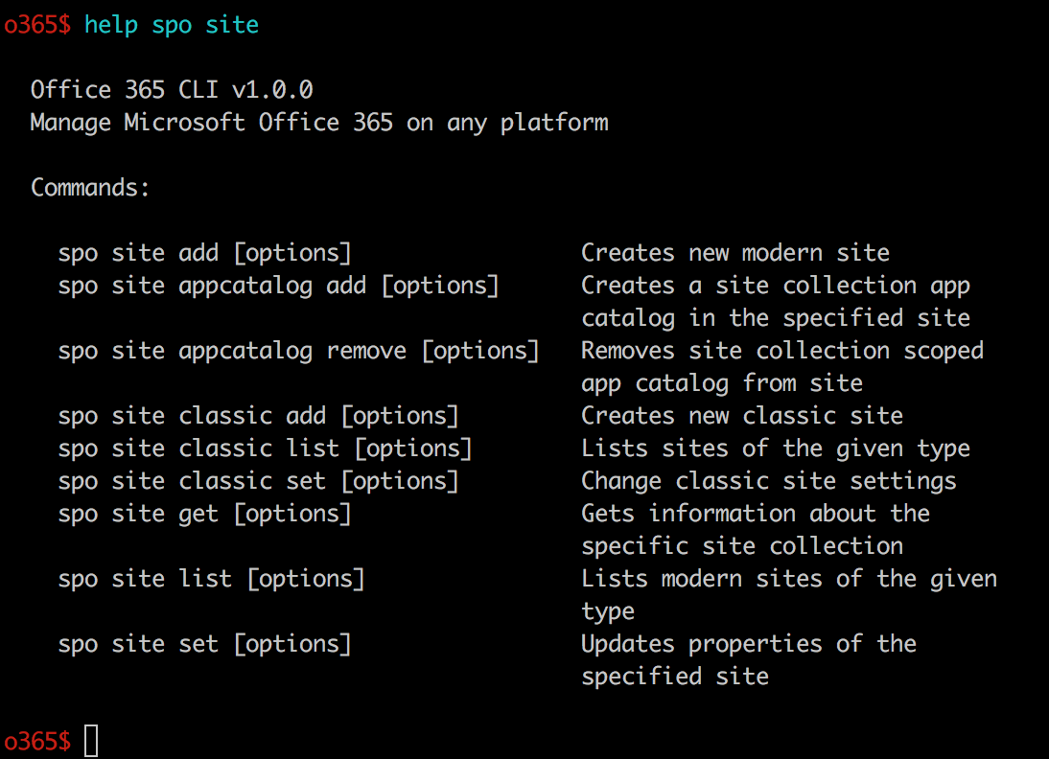

Slide 34
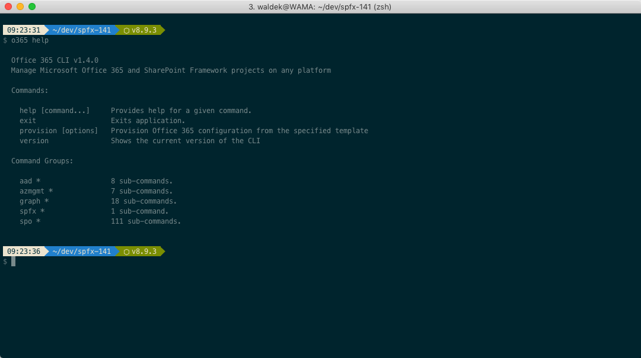

Slide 35
Key Takeaways
Get familiar with PowerShell if you aren’t already
Learn how to work with modules
Learn to use Visual Studio Code
Know where to get the modules you need
Tap into the power of community and contribute

